Slide 1
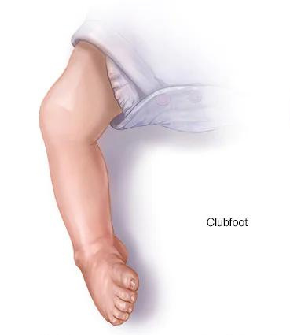
Case Study on
Clubfoot
A congenital deformity

Slide 2
Our Team
List of key concepts
- Md Nehamul Islam Nehad
- Sunayda Jahan Sruty
- Ridoy Chandra Roy
- Md Abu Sadat Soash
- Shatabdi Roy
- Alvee Alam
- Jahidul Islam Shovo
- Shadman Mutassim Efad
- What is clubfoot?
- Causes of Clubfoot
- Status of Clubfoot
- How we conducted
- Symptoms
- Treartment
- Ponseti method
- Patients overview
- Current status in Bangladesh
- To solve

Slide 3
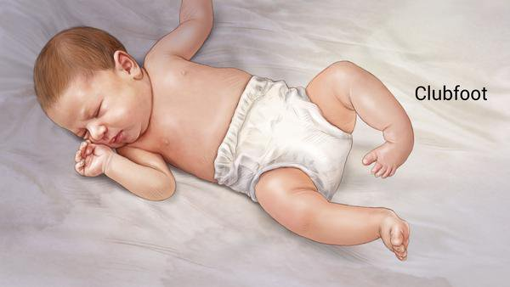
What is
Clubfoot?
A congenital deformity
that affects the feet, typically characterised by a medial deviation of the heel, a lateral deviation of the forefoot, and an inverted position of the ankle.

Slide 4

The condition can be caused by a combination of genetics and environmental factors.
Abnormalities are caused by deletions and duplications of the chromosome 17q23
Chromosomal abnormalities have been found in 30% of complex clubfoot cases and 2% of isolated clubfoot cases, including trisomy 18, 13, 21, sex chromosome

Slide 5

1 in 1000
newborns are affected worldwide
5000 Children
are born with club foot each year in Bangladesh

Slide 6
How we conducted
the case study
  We visited a number of hospitals across Bangladesh
  We also conducted door-to-door interviews
  We made a special form to collect information
  We communicated with some private organizations
  We collected information from different websites

Slide 7
What we
Found?

Slide 8

Foot that turns inward and downward
Heel that points upward
Symptoms
Shortened Achilles tendon
Difficulty moving the foot

Slide 9
Treatment
surgery
9.5%
We found that, surgery has been done for treatment for only two case and in the rest of the cases Ponseti method is used.
So far Ponseti method is most famous.
cast
42.9%
shoes
47.6%

Slide 10
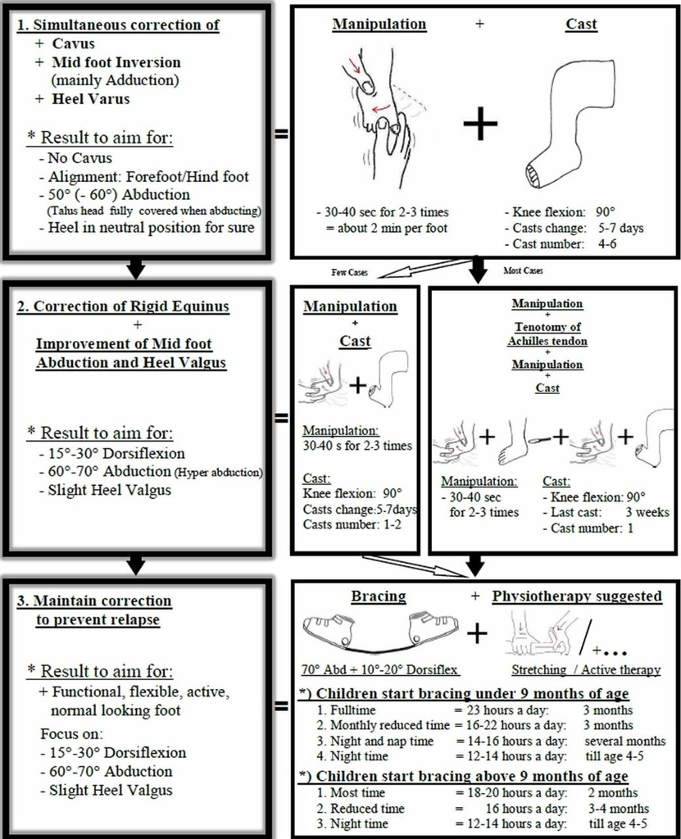
Ponseti Method

Slide 11
Patients overview
Age
Patients
age range
60
40
20
was from 35 days to 55 years
0
1
2
3
4
5
6
7
8
9
10
11
12
13
14
15
16
Patients Sex
female
43.8%
out of 16 cases 9 were male; indicating it is more frequent in male
male
56.3%

Slide 12
Current status in
Bangladesh?
according to the National Strategy and Action Plan for Clubfoot Care in Bangladesh-
  the country has a network of Ponseti Clubfoot clinics at 44 medical college and district hospitals, managed by national and international non-government organizations.
  only 3 of these clinics are specialized hospitals, and 24 are secondary level hospitals.

Slide 13




To solve
  number of facilities providing treatment for clubfoot has to be increased
  Proper caring during pregnancy
  Making people aware

Slide 14

Thank You :3

